Slide 1
Group no:03

Slide 2
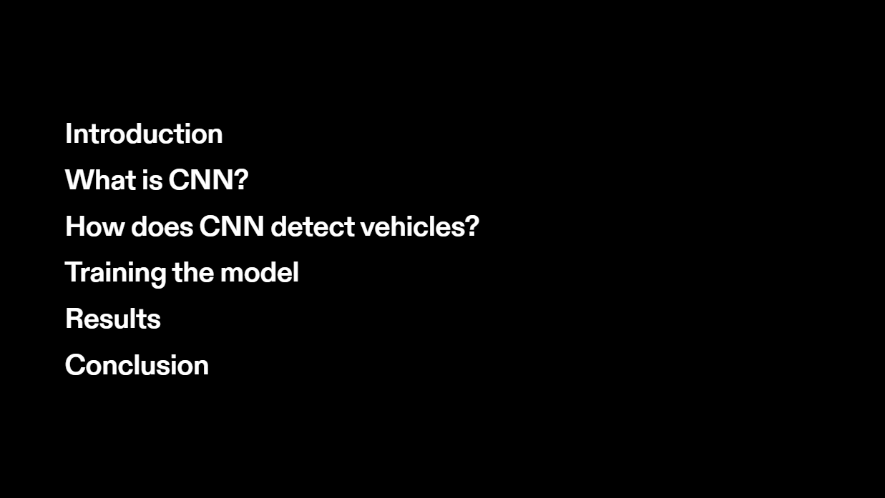

Slide 3
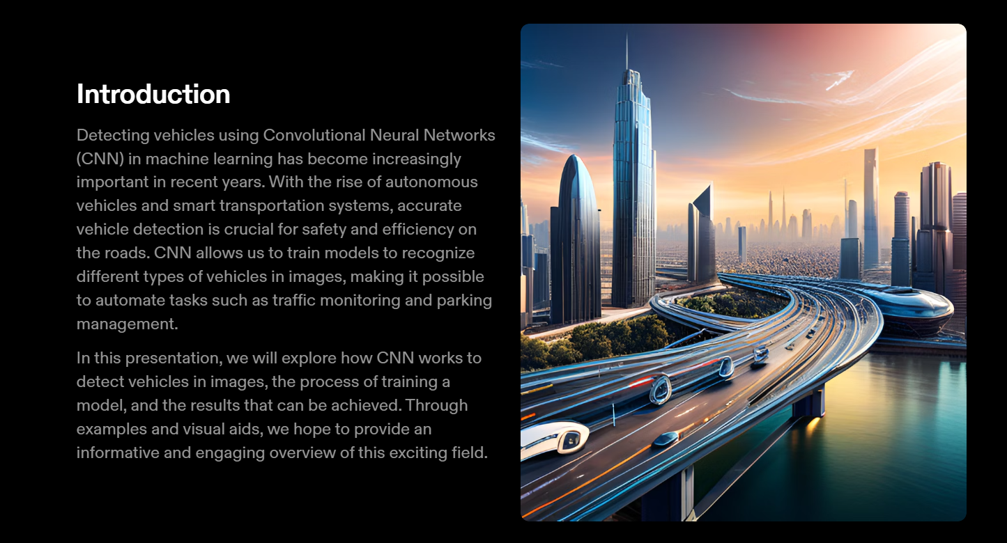

Slide 4
Topic: Vehicle Detection using CNN

Slide 5
Classification Category:
1.Heavy Vehicles
2.Bike
3.SUV
4.Cycle
5.Sedan

Slide 6
Accuracy-99.8%
Validation Accuracy-81.58

Slide 7
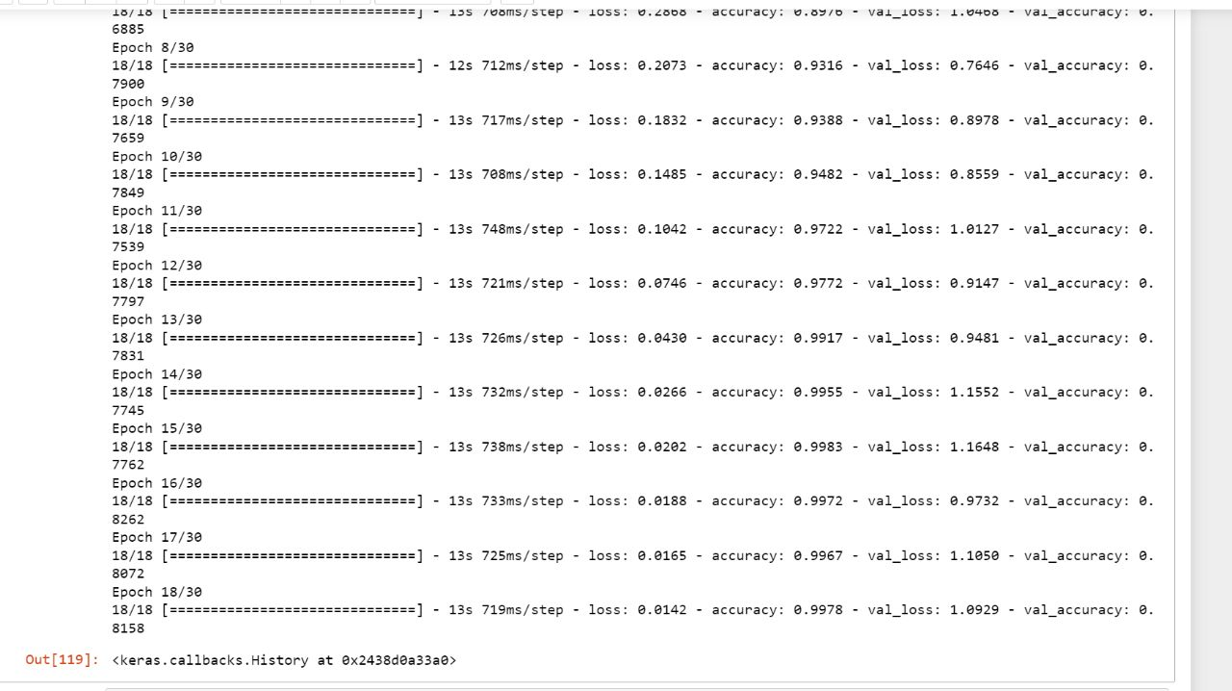

Slide 8
Dataset
Category | Train | Test
Heavy Vehicles | 300 | 100
SUV | 300 | 100
Sedan | 300 | 100
Bike | 300 | 100
Cycle | 300 | 100

Slide 9
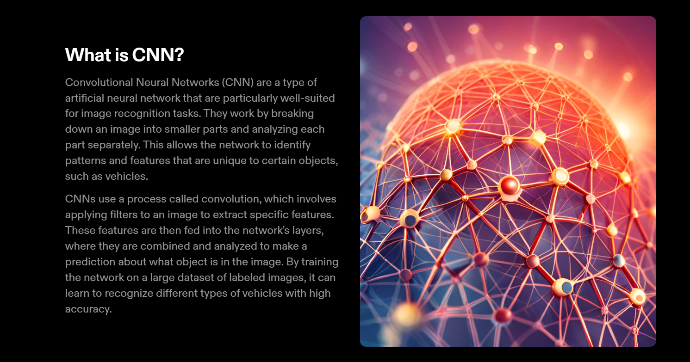

Slide 10
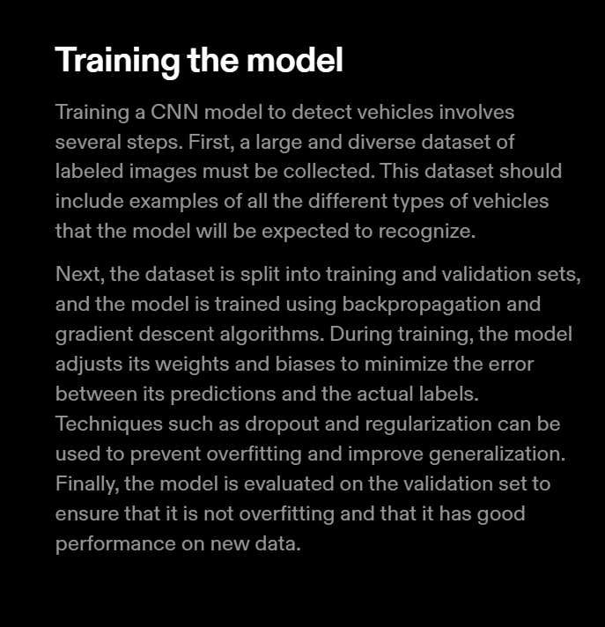
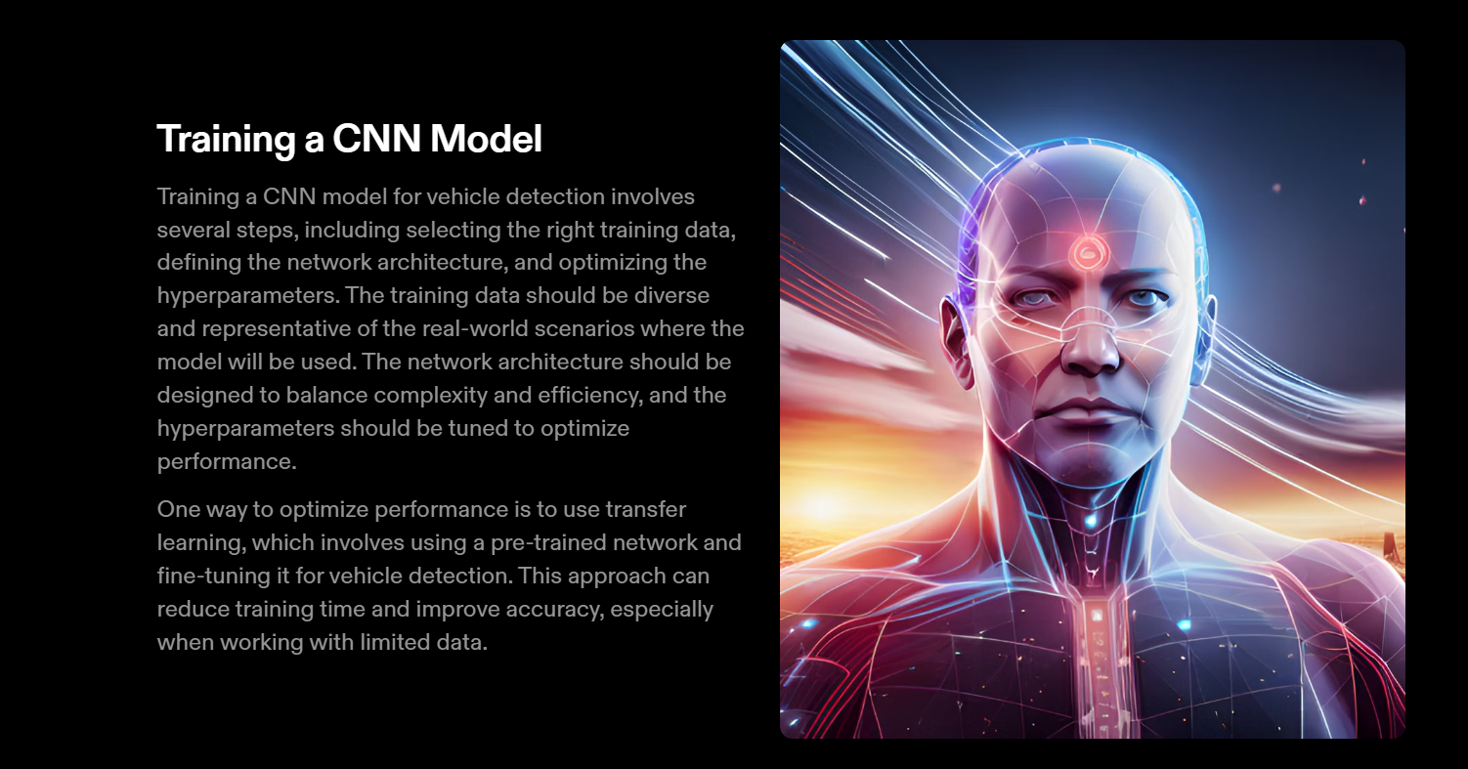

Slide 11
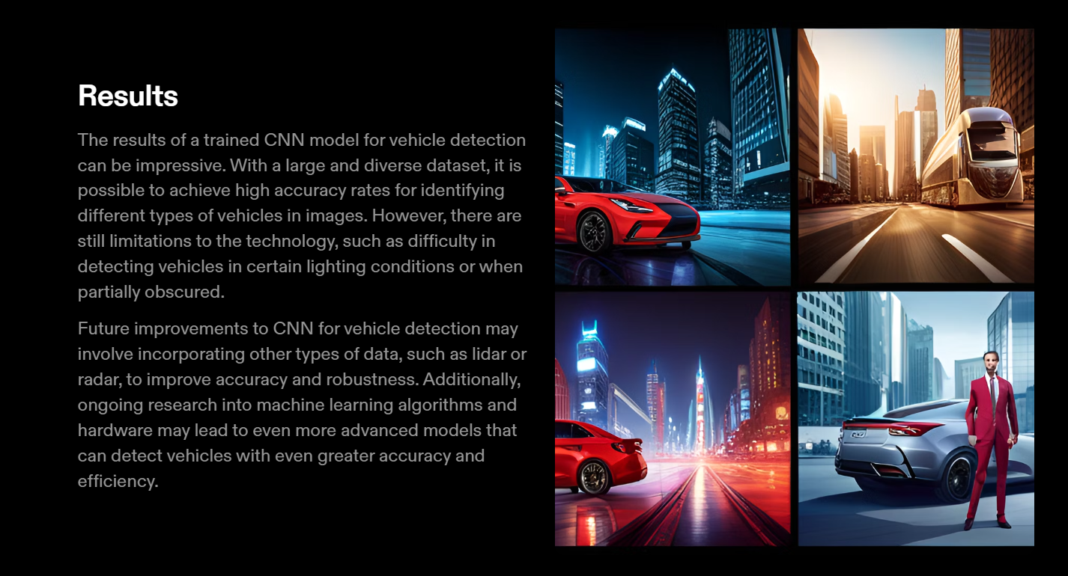

Slide 12
